Slide 1
Data Storytelling & Statistical Validation
Srilekha Mallela Data Analyst Internship Project

Slide 2
Understanding customer behavior and factors affecting spending and retention.
Understanding customer behavior is crucial for improving business performance.
The goal of this project is to analyze how factors like membership type, discounts, satisfaction levels, and demographics influence customer spending and retention.
This helps businesses make data-driven decisions to increase revenue and customer engagement.

Slide 3
- Customer behavior dataset - Features
The dataset contains customer behavior data from an e-commerce platform.
It includes key attributes such as:
- Age
- Membership Type
- Total Spend
- Discount Applied
- Satisfaction Level
- City
- Days Since Last Purchase
This data is used to analyze spending patterns, customer satisfaction, and retention behavior.

Slide 4
Membership vs Spend
The following key analyses were performed to understand customer behavior:
- Membership Type vs Total Spend
- Discount Impact on Spending
- Satisfaction Level vs Spending
- Age Distribution of Customers
- City-wise Spending Patterns
These analyses help identify factors influencing customer purchasing behavior and business performance.

Slide 5
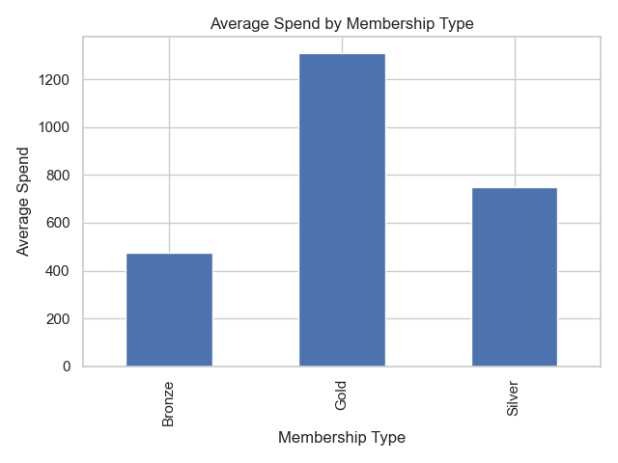
Premium members spend more than others

Slide 6
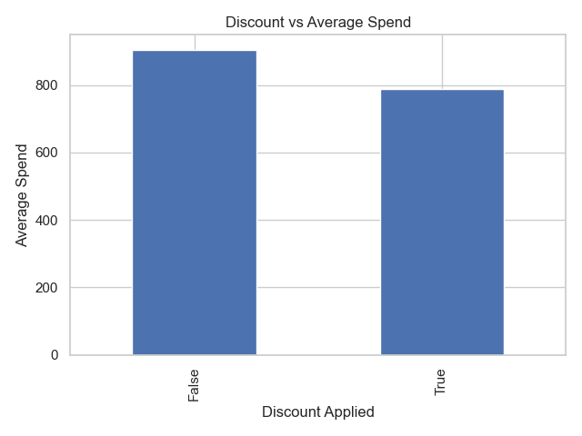
Discounts increase customer spending

Slide 7
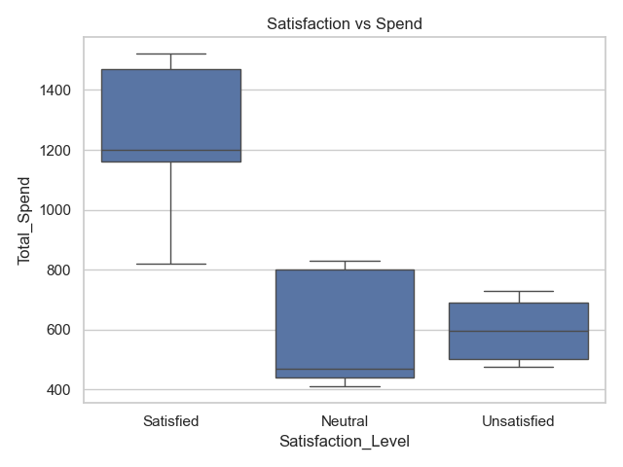
Higher satisfaction leads to higher spending

Slide 8
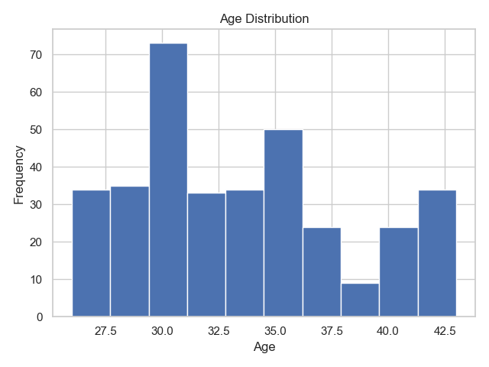
Major customers fall in specific age groups

Slide 9
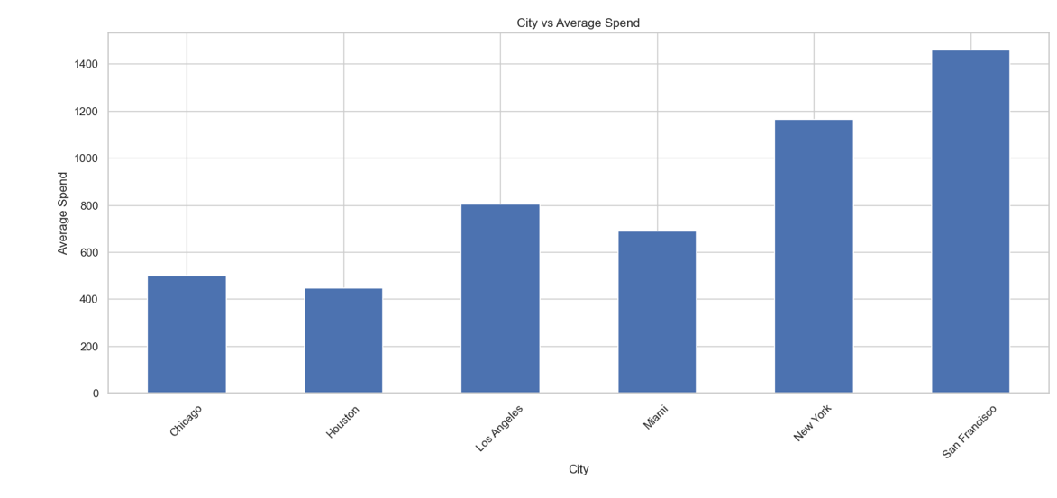
Some cities contribute more revenue

Slide 10
Hypothesis Testing
Hypothesis:
Discounts have an impact on customer spending behavior.
Test Used:
Independent T-Test
Result:
P-value < 0.05
Conclusion:
There is a statistically significant difference in spending between customers who received discounts and those who did not.
This confirms that discounts influence customer purchasing behavior.

Slide 11
Key Insights
- Premium users generate higher revenue
- Discounts effectively boost sales
- Customer satisfaction drives purchasing behavior
- Revenue varies across cities
- Customer retention is a key challenge (inactive users identified)

Slide 12
Business Recommendations
- Provide targeted discounts to increase customer spending
- Focus on retaining high-value (premium) customers
- Improve customer satisfaction through better services
- Launch re-engagement campaigns for inactive customers
- Use data-driven strategies for marketing and sales optimization

Slide 13
Conclusion
This project demonstrates how data analysis and statistical validation can help understand customer behavior.
By leveraging insights from data, businesses can improve decision-making, increase revenue, and enhance customer retention.
Data-driven strategies are essential for sustainable business growth.

